Slide 1
Image Captioning
Chirag 18001003031
Ankit 18001003018
May 6 2021

Slide 2
Introduction
Image Captioning is the process of generating textual
description of an image. It uses both Natural Language
Processing and Computer Vision to generate the
captions.

Slide 3
Motivation
Self Driving car
Aid to the Blind people
Image search engine
Can be used to describe videos in real time
In CCTV camera

Slide 4
Image captioning has various applications such as recommendations in editing applications, usage in virtual assistants, for image indexing, for visually impaired persons, for social media, and several other natural language processing applications.
We can create a product for the blind which will guide them travelling on the roads without the support of anyone else. We can do this by first converting the scene into text and then then text to voice. Both are now famous applications of Deep Learning.
CCTV cameras are everywhere today, but along with viewing the world, if we can also generate relevant captions, then we can raise alarms as soon as there is some malicious activity going on somewhere. This could probably help reduce some
crime and/or accidents.

Slide 5
DATA COLLECTION
There are many open source datasets available for this problem, like Flickr 8k (containing 8k images), Flickr 30k (containing 30k images), MS COCO (containing 180k images), etc. But for the purpose , I have used the Flickr 8k dataset which can be download from kaggle. Also training a model with a large number of images may not be feasible on a system which is not a very high end PC/Laptop.
This dataset contains 8000 images each with 5 captions (as we have already seen in the Introduction section that an image can have multiple captions, all being relevant simultaneously).
These images are bifurcated as follows:
Training Set — 6000 images
Dev Set — 1000 images
Test Set — 1000 images

Slide 6
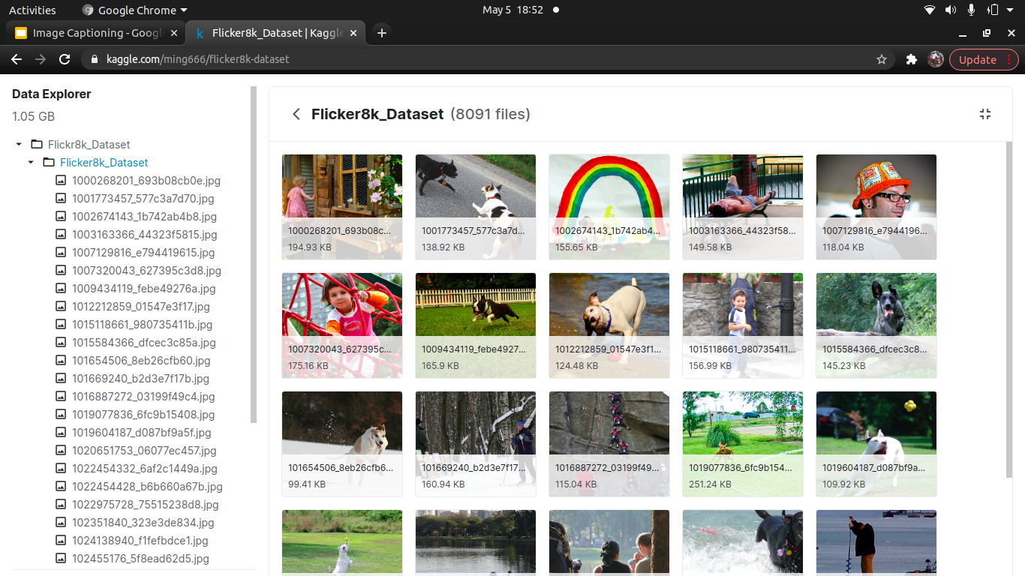
Glance of the dataset

Slide 7
Major Libraries used….
Libraries
Pandas:- For manipulating the dataset
Numpy:- To deal with multi dimensional arrays
Matplotlib:- For Visualization
Tensorflow:-For Numerical computation
Keras:- high-level API of TensorFlow
Nltk:- for language processing, contain
common algorithms such as tokenizing,
part-of-speech tagging

Slide 8
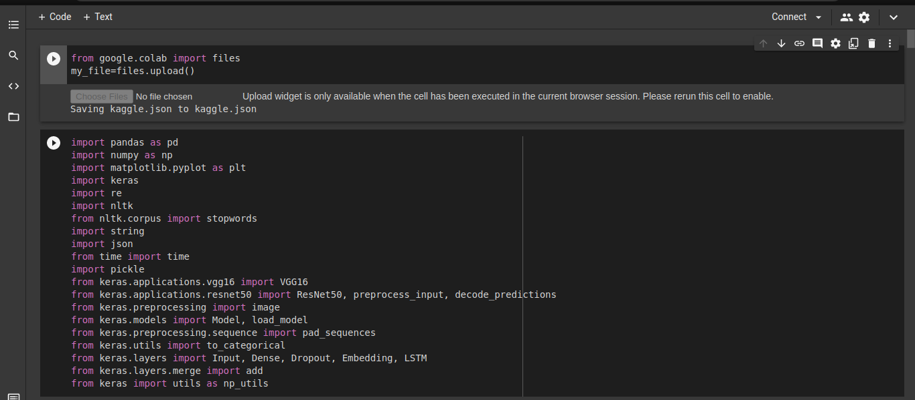
Libraries Importing

Slide 9
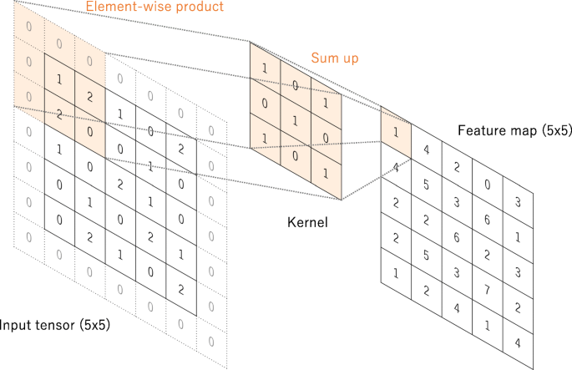
CNN
Convolutional neural network is composed of multiple building blocks, such as convolution layers, pooling layers, and fully connected layers, and is designed to automatically and adaptively learn spatial hierarchies of features through a backpropagation algorithm
Its role is to reduce the images into a form which is easier to process, without losing features which are critical for getting a good prediction
Convolution operation

Slide 10

Working of Convolution neural network

Slide 11
Cnn model used in this project
In this model we have Resnet-50 cnn model and have used the pretrained weights, trained on imagenet dataset
Resnet-50 consist of 50 deep neural layers and is capable of categorizing 1000 image categories

Slide 12
Recurrent neural network
RNNs in general and LSTMs in particular have received the most success when working with sequences of words and paragraphs, generally called natural language processing.
This includes both sequences of text and sequences of spoken language represented as a time series. They are also used as generative models that require a sequence output, not only with text, but on applications such as generating handwriting.
Use RNNs For:
• Text data
• Speech data
• Classification prediction problems
• Regression prediction problems
• Generative models

Slide 13
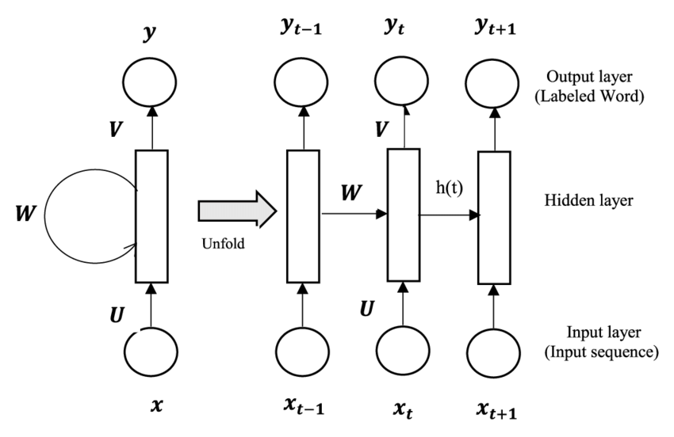
Rnn training flow

Slide 14
Concepts Used
1.Encoder
2.Decoder
3.Attention
4.Transfer Learning
5.Beam Search

Slide 15
Encoder
For Encoder we use ResNet-50. ResNet-50 is a convolutional neural network that is trained on more than a million images from the ImageNet database. The network is 50 layers deep and can classify images into 1000 object categories, such as keyboard, mouse, pencil, and many animals.
As a result, the network has learned rich feature representations for a wide range of images. The network has an image input size of 224-by-224.

Slide 16
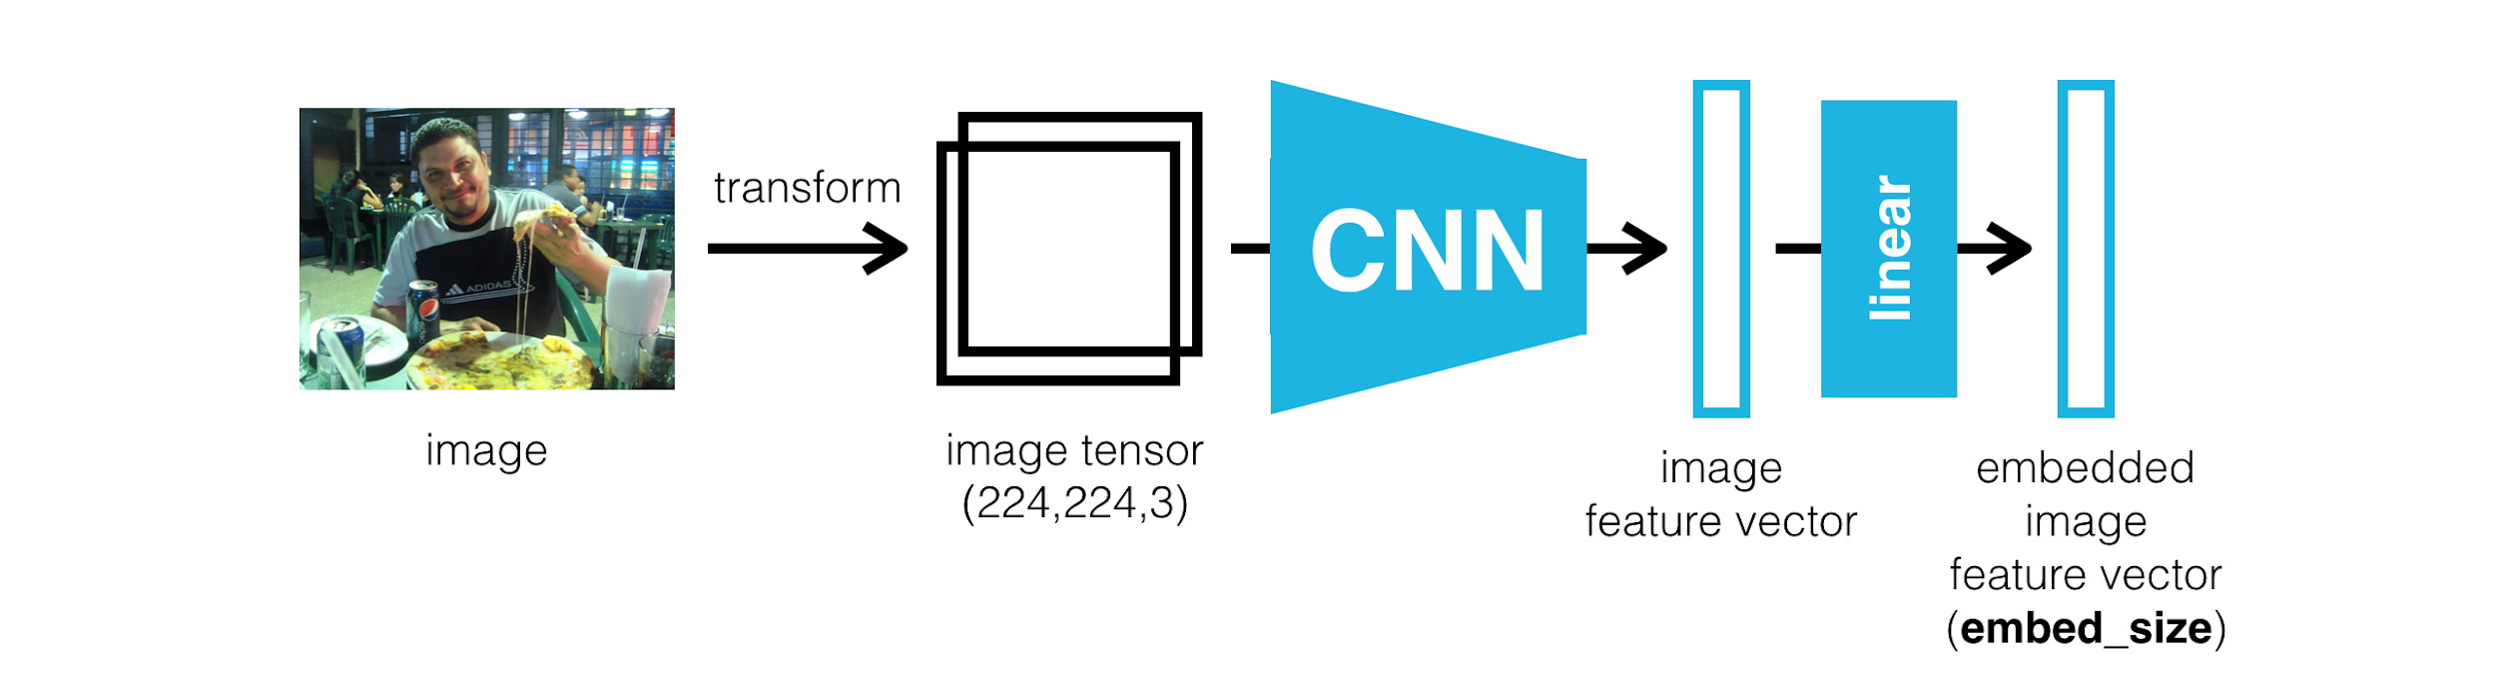
After removing the last layer of cnn, we pass this image feature vector to next model

Slide 17
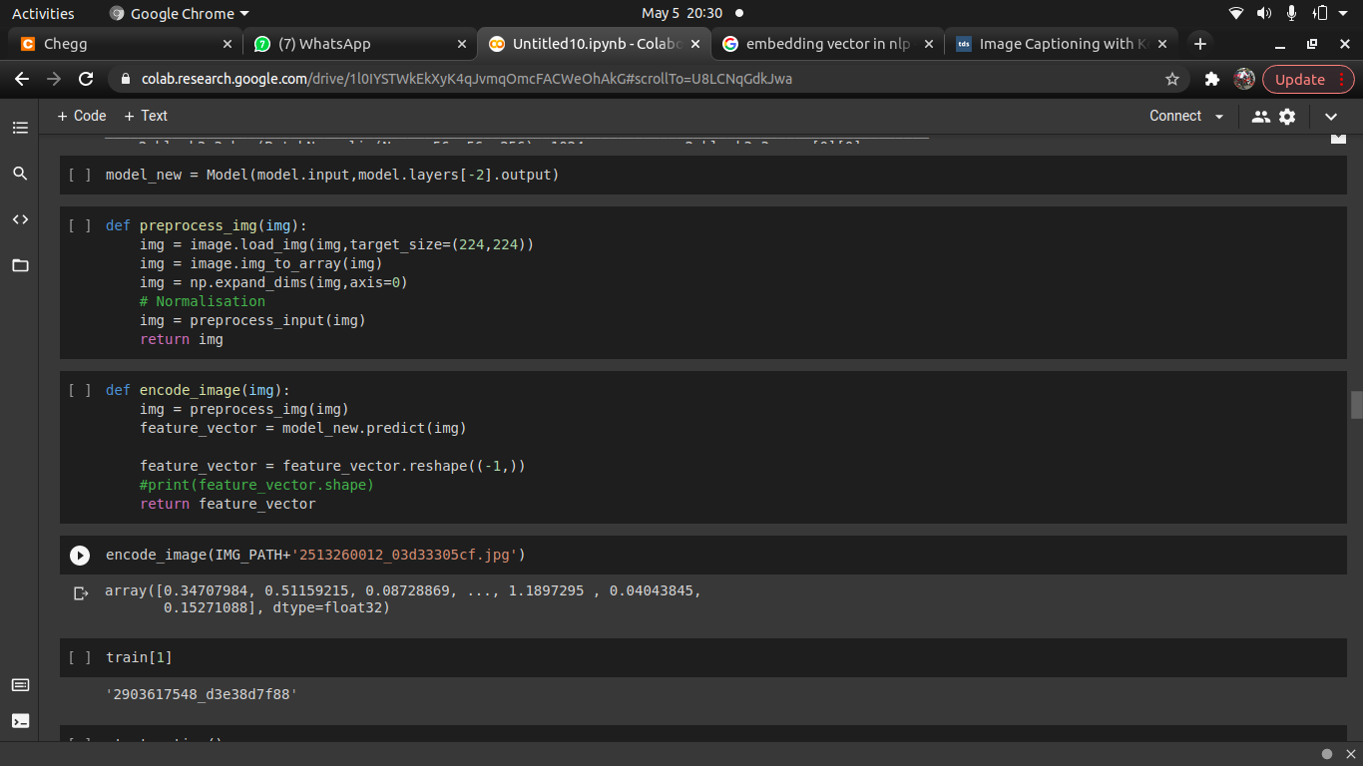
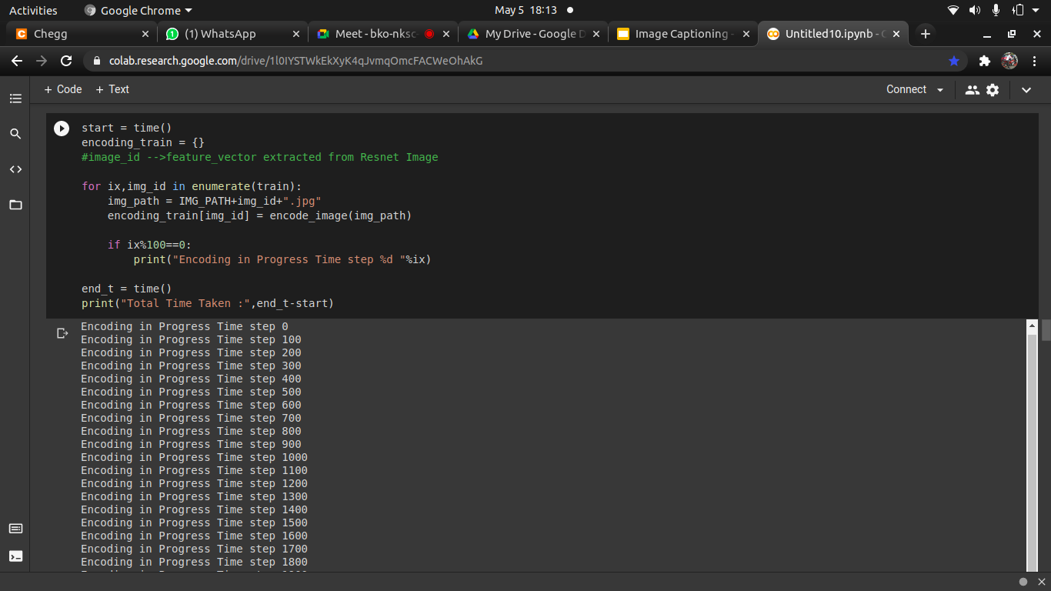

Slide 18
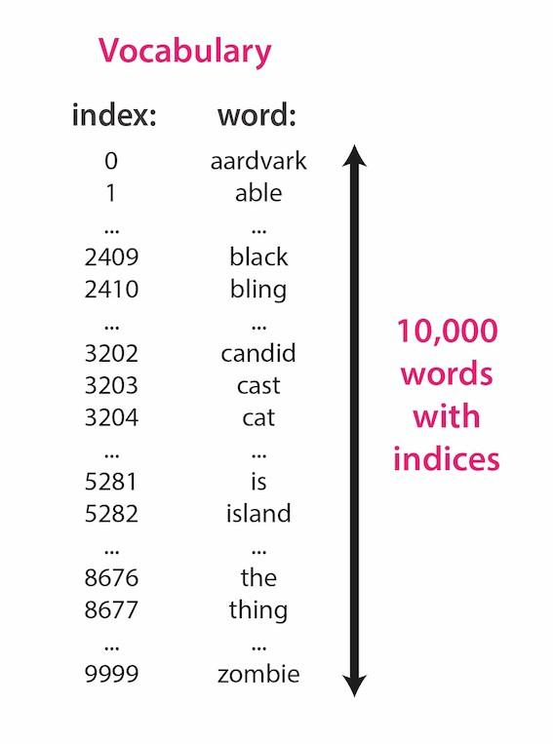
Word Embedding
First of all we should know what is vocabulary
Each word will be represented as an n-dimensional vector, where n is the vocabulary size
Each word’s vector representation will be mostly “0”, except there will be a single “1” entry in the position corresponding to the word’s index in the vocabulary.
This process is called one-hot vector encoding

Slide 19
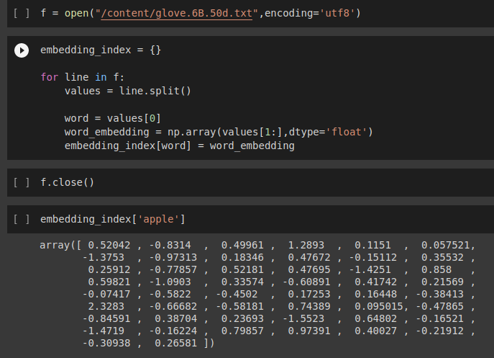

Slide 20
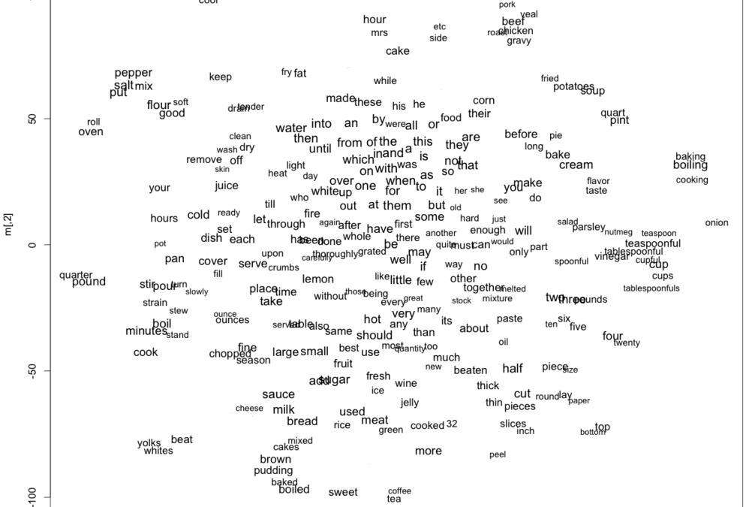
Word2Vec

Slide 21
Decoder
For Decoder we use LSTM. Long Short-Term Memory (LSTM) networks are a modified version of recurrent neural networks, which makes it easier to remember past data in memory. The vanishing gradient problem of RNN is resolved here. LSTM is well-suited to classify, process and predict time series given time lags of unknown duration. It trains the model by using back-propagation

Slide 22
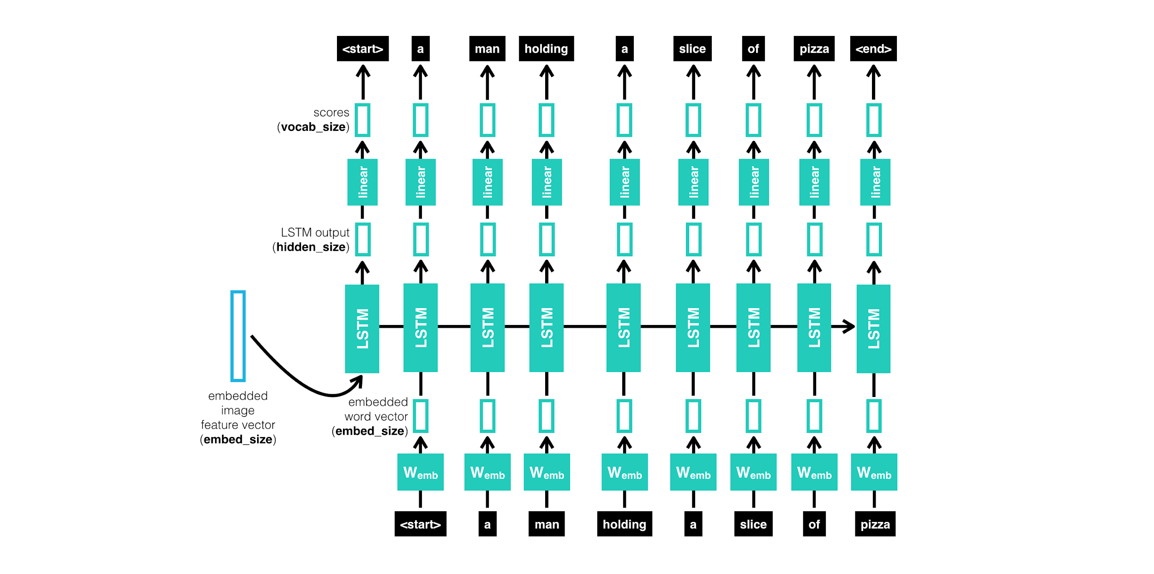

Slide 23
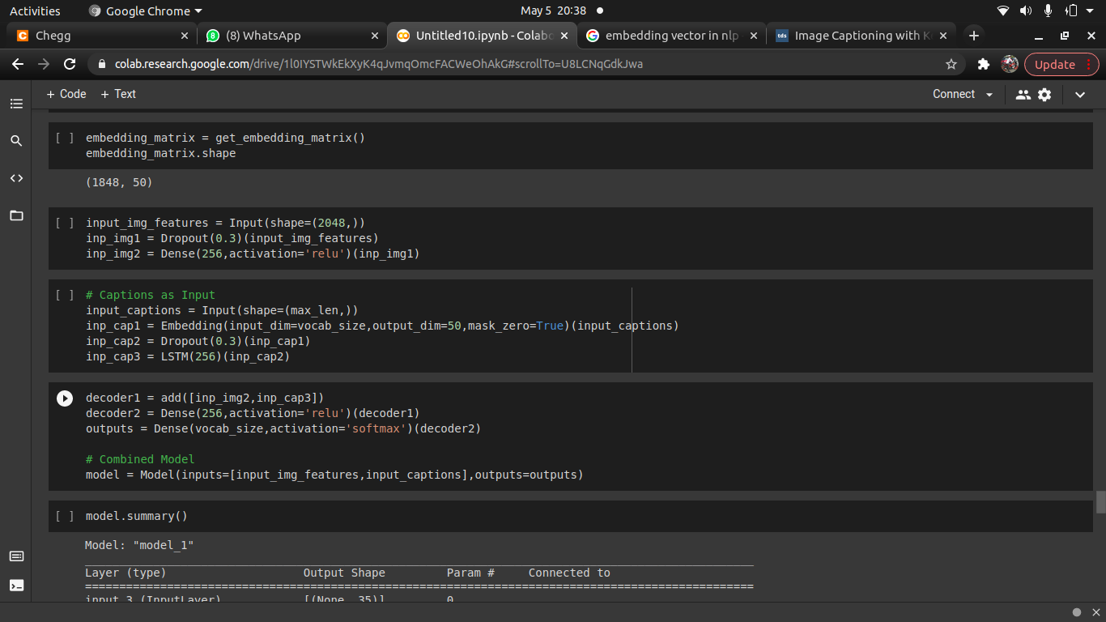
Decoder structure
With all the input layers

Slide 24
Beam Search
At the first decode step, consider the top k candidates.
Generate k second words for each of these k first words
Choose the top k [first word, second word] combinations considering additive scores.
For each of these k second words, choose k third words, choose the top k [first word, second word, third word] combinations.
Repeat at each decode step.
After k sequences terminate, choose the sequence with the best overall score.

Slide 25
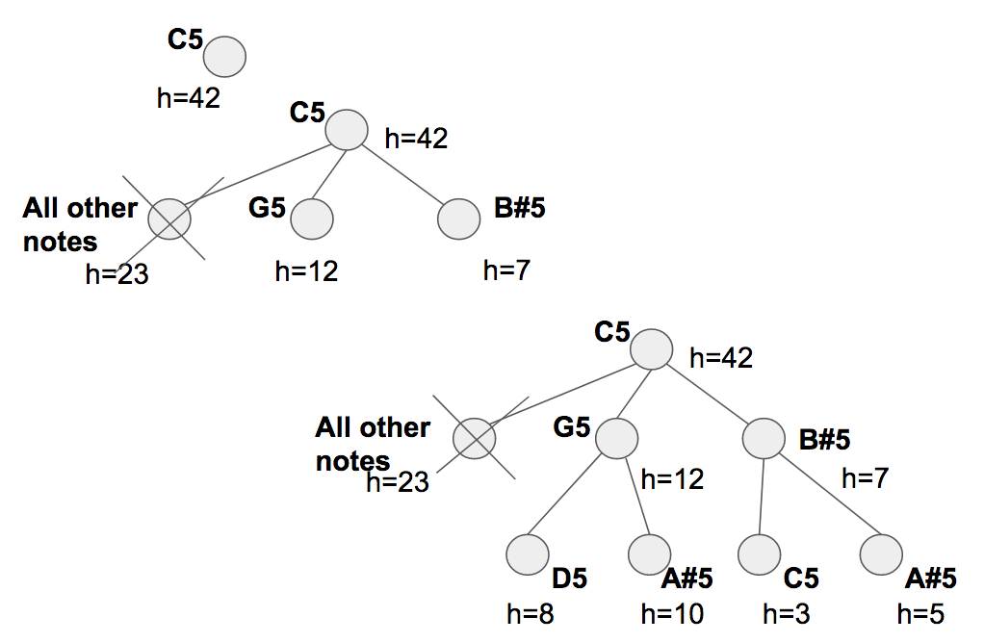
Beam Search

Slide 26
Attention
The Attention network computes these weights
Intuitively, how would you estimate the importance of a certain part of an image? You would need to be aware of the sequence you have generated so far, so you can look at the image and decide what needs describing next. For example, after you mention a man, it is logical to declare that he is holding a football.
This is exactly what the Attention mechanism does – it considers the sequence generated thus far, and attends to the part of the image that needs describing next.

Slide 27
Implementation
We will need three inputs
Images:- images fed to the model must be a Float tensor of dimension N, 3, 256, 256, and must be normalized by the aforesaid mean and standard deviation. N is the batch size.
Caption:-Captions are both the target and the inputs of the Decoder as each word is used to generate the next word.
Caption Length:-Since the captions are padded, we would need to keep track of the lengths of each caption.
We only process a sequence up to its length and don't waste computation
Therefore, caption lengths fed to the model must be an Int tensor of dimension N.

Slide 28
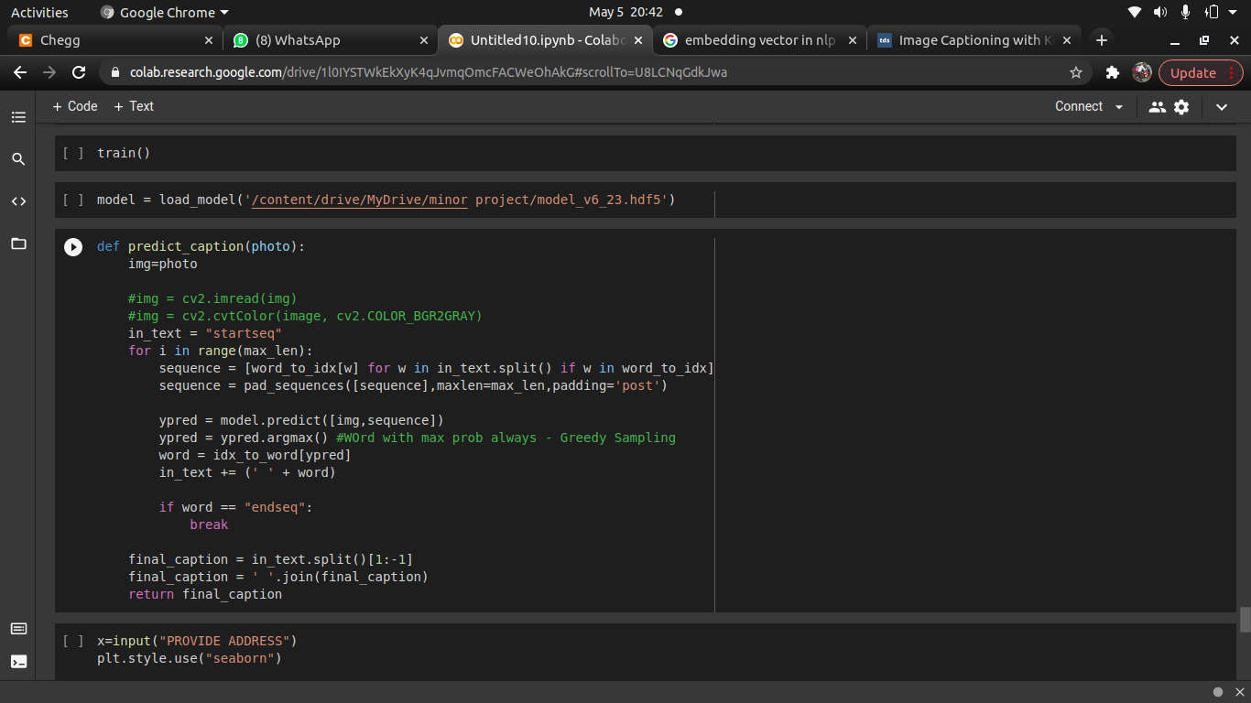
Finally we are in Prediction phase

Slide 29
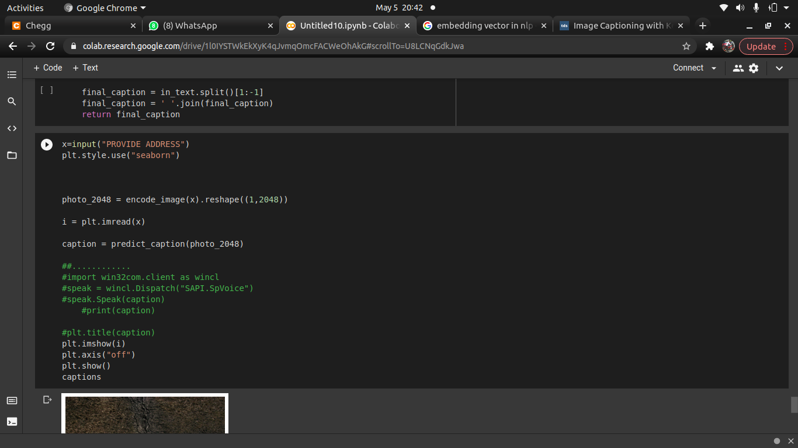

Slide 30
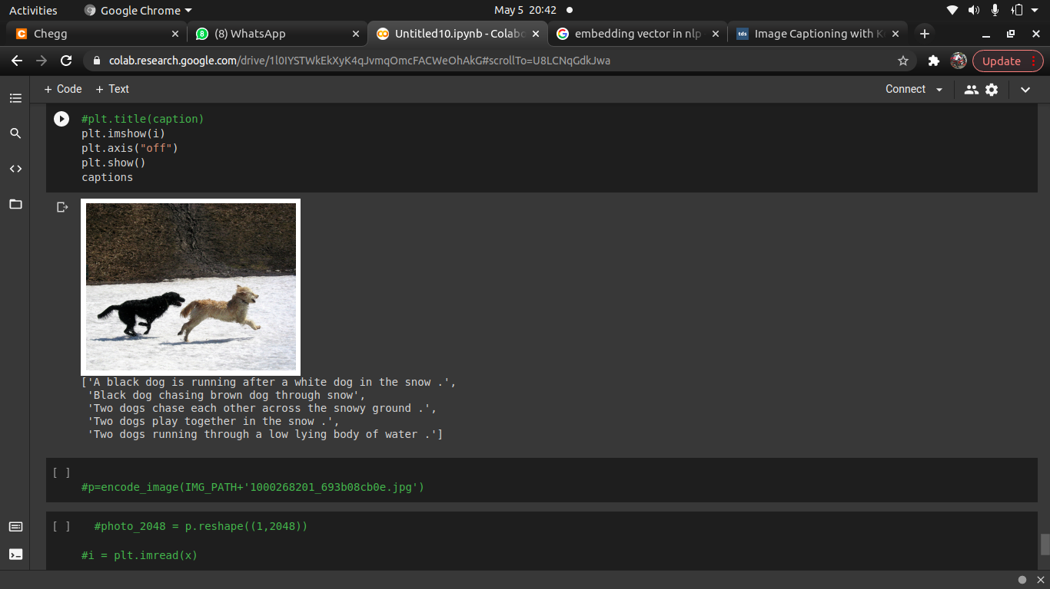

Slide 31
ThankYou
Regards:-
Ankit(18001003018)
chirag(18001003031)

